Slide 1
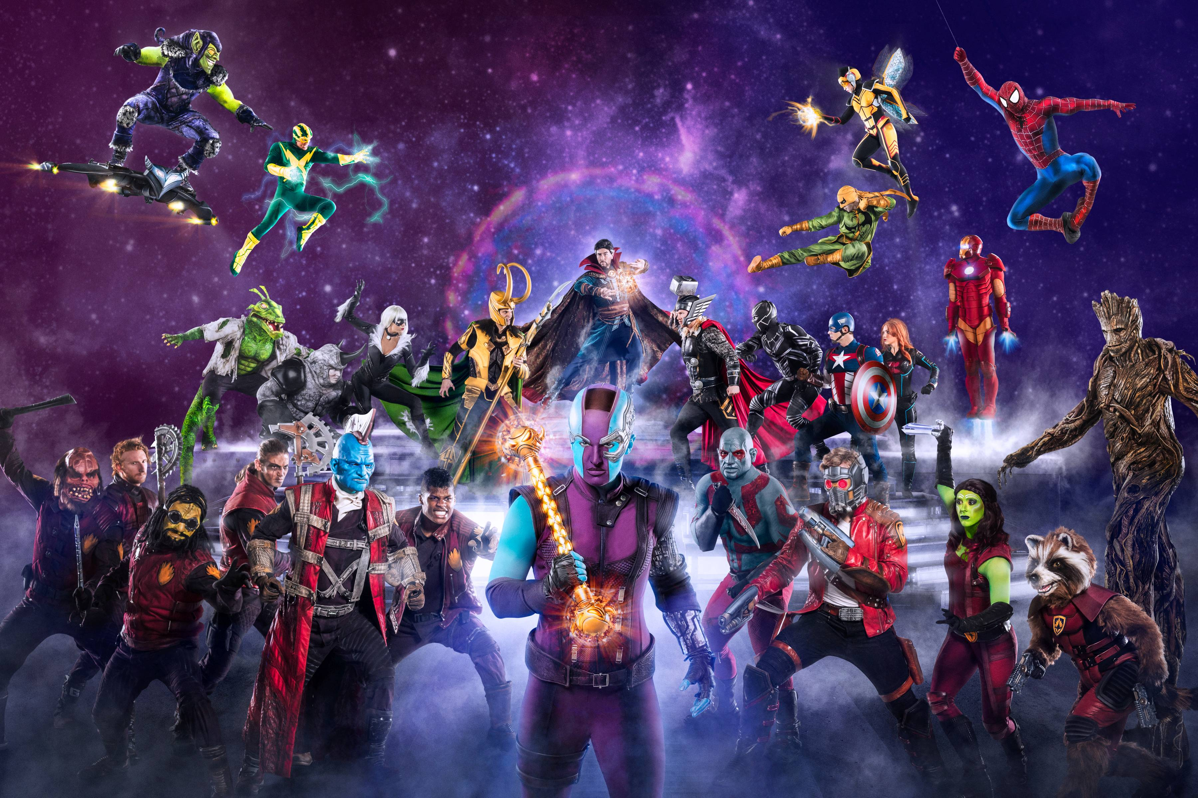
An Exploratory Analysis of Marvel and DC Characters
FR
FABRIKAM RESIDENCES
Created by Alexandros Koutroularis

Slide 2
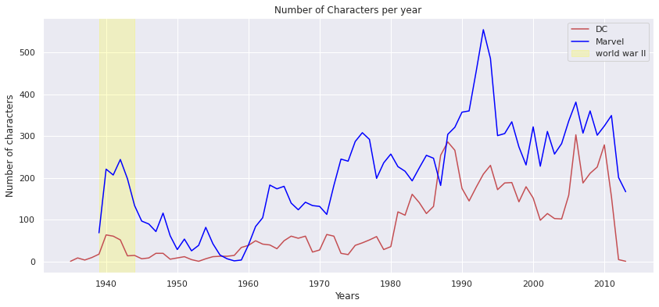
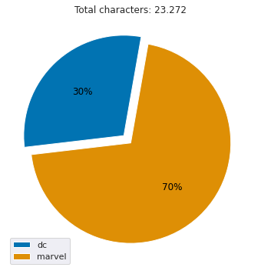
From a total of 23.272 characters, Marvel dominates with 16.376 against 6.896 of DC
We can observe a significant development of new comic characters during the World War II, often portrayed as fighting against the Nazis and the Japanese

Slide 3
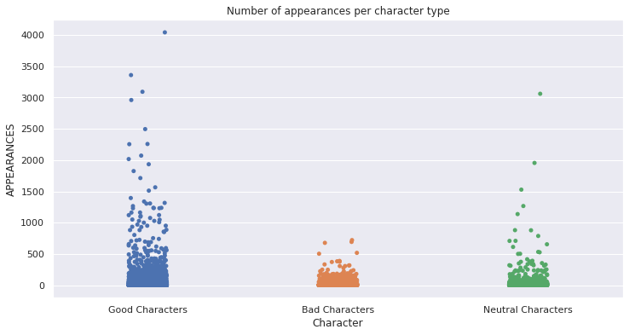
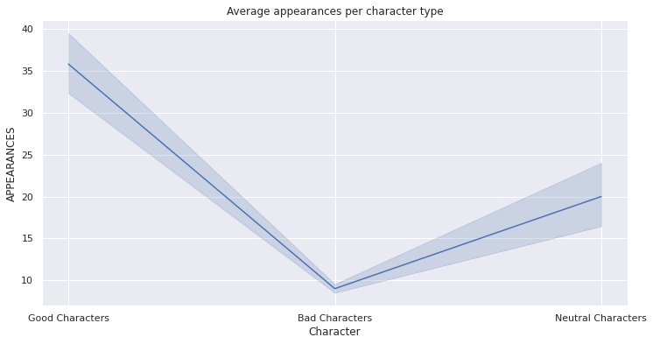
We can observe that good and neutral characters tend to appear more and stay alive for a longer period than the bad
The good characters appear 35 times on average, as opposed to the bad ones which appear about 9 times

Slide 4
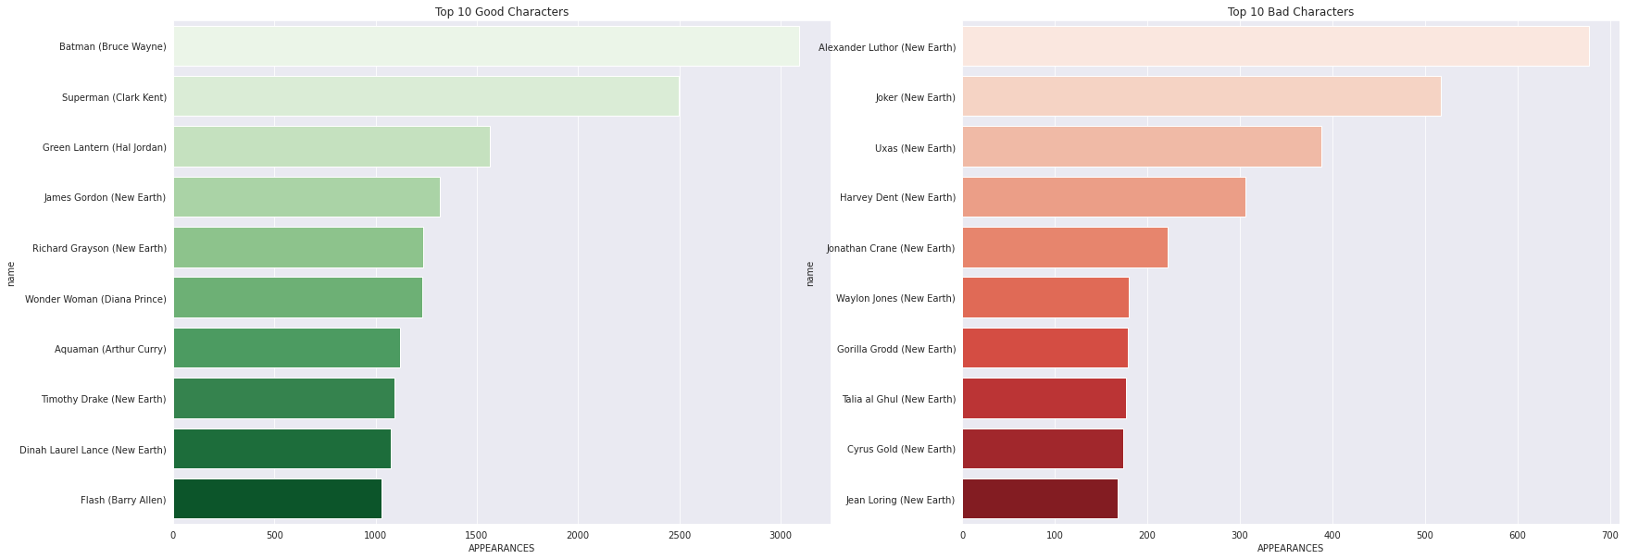
Top 10 Good and Bad characters

Slide 5
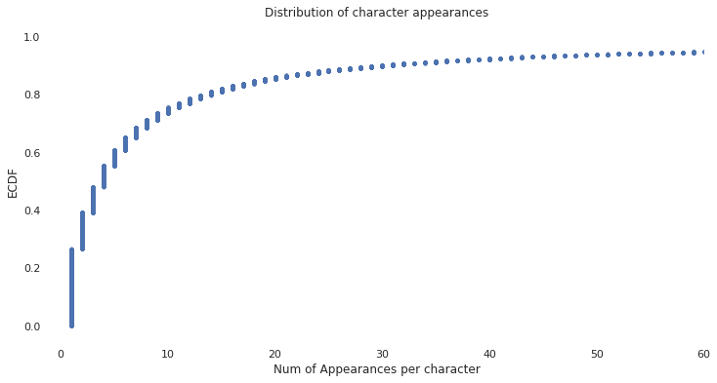
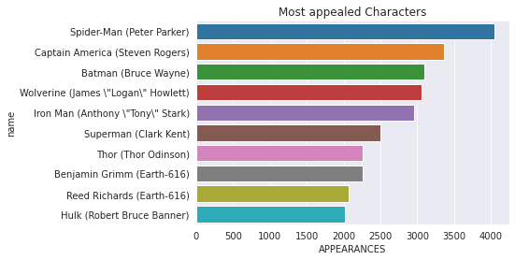
Almost 90% of the characters have been appeared 30 times at most
Top 10 characters with the most appearances

Slide 6
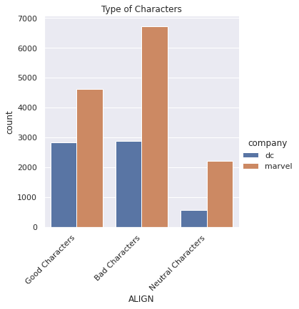
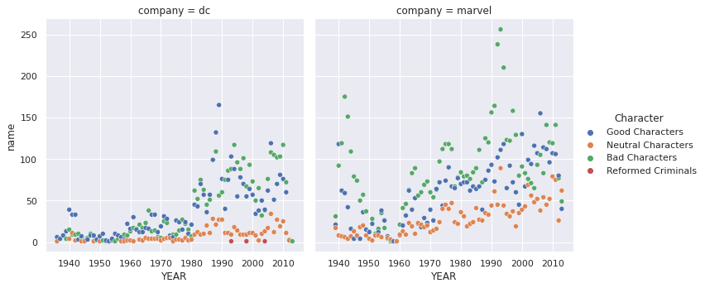
The first bad characters introduced in 1939, where 39 belonged to Marvel and 4 to DC
Historically, bad characters dominates in Marvel’s universe, where DC seems to keep a balance between bad and good
Regarding the Neutral characters, it seems they followed a linear trend throughout the years, in contrast to good and bad characters which exponentially developed from 1970

Slide 7
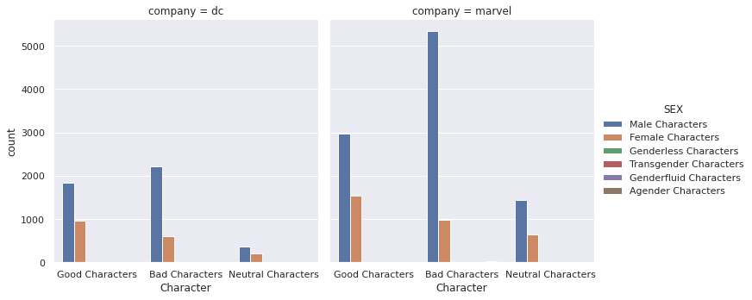

Historically, there have been a significant underrepresentation of female characters

Slide 8
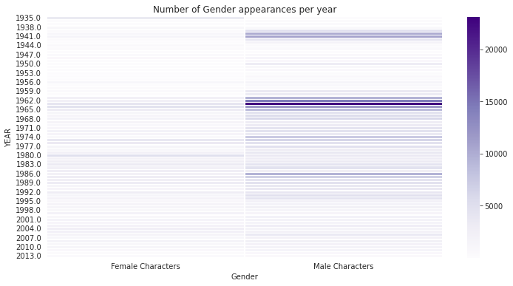
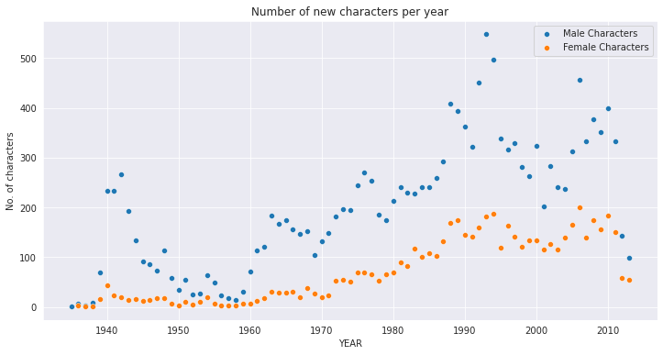
Male characters have traditionally the most appearances, with a pick in the 60’s and 70’s

Slide 9
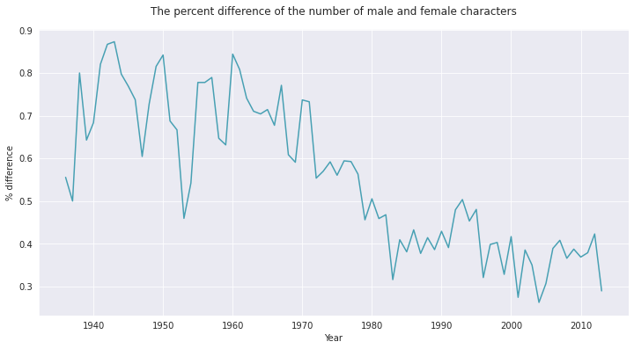
In 1942 almost 94% of total characters were male and only 6% were female
The women rights movement during the 70’s, had a positive impact on the underrepresentation
Thus, from 1980, the difference between male and female representation has significantly decreased
Although, the difference remain between 35% and 40%, showing that there are still lot to be done

Slide 10
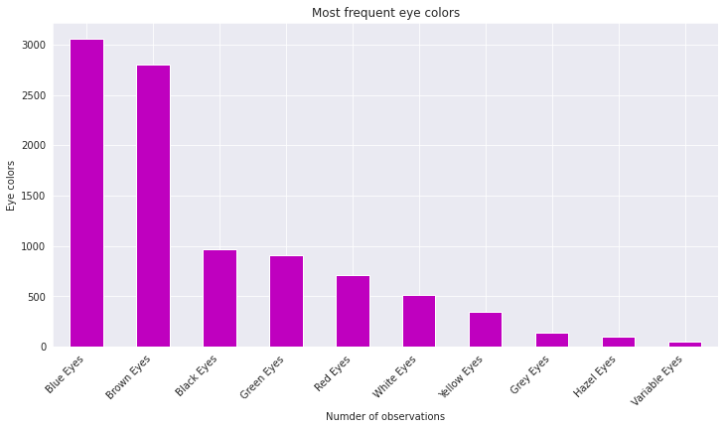
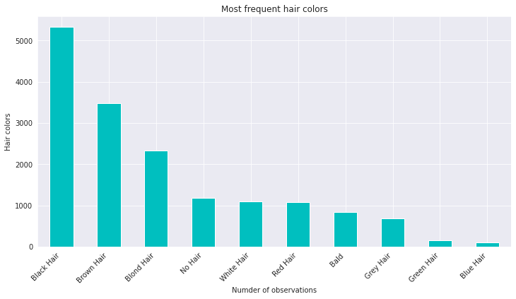
The most popular eye colors are blue or brown and almost 70% of characters have black, brown or blond hairs

Slide 11
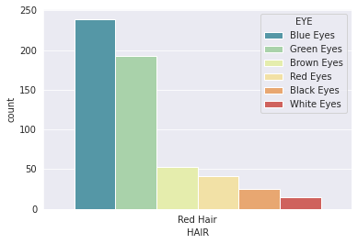
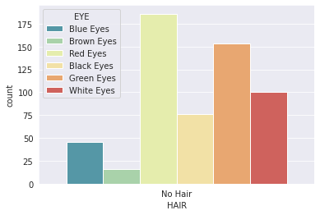
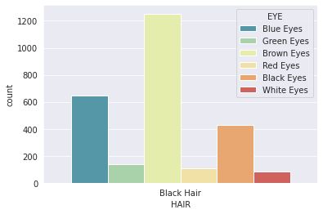
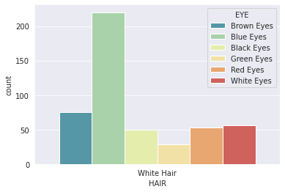
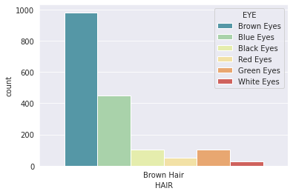
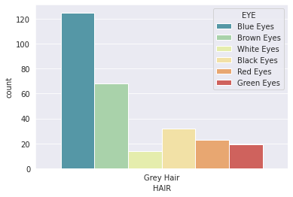
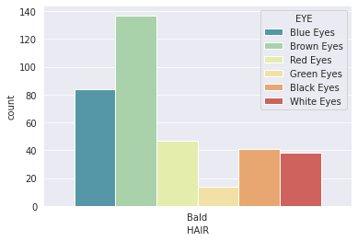
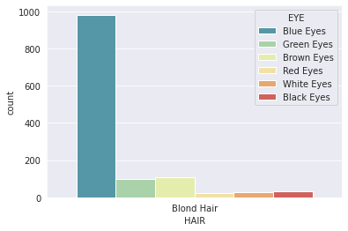
Relationship of hair and eye colors
Characters with red, grey, white or blond hairs tend to have blue or green eyes
In characters with black and brown hair the most frequent eye colors are brown or blue
White eyes dominates in characters with blond hairs
On bald or no hair characters we can observe a variety of eye colors

Slide 12
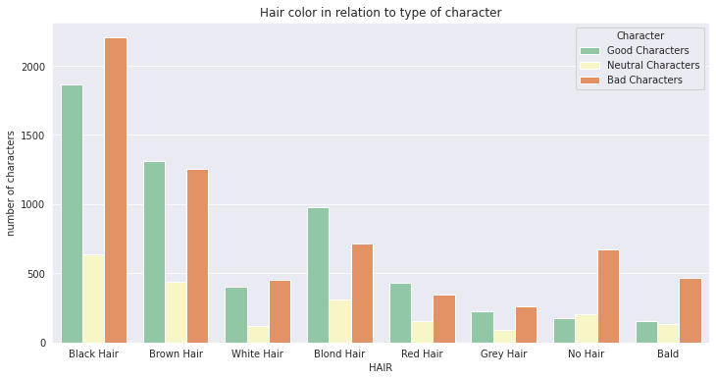
Bad characters are extremely more likely to be bald or with no hair
Most blond and red hair characters are good
There are more bad than good characters that have black hairs
Neutral characters are not inclined to a specific hair color

Slide 13
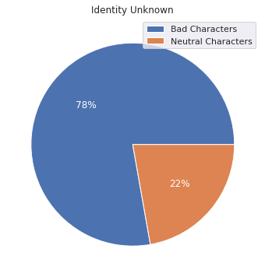
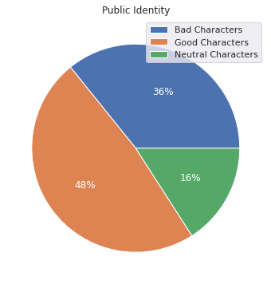
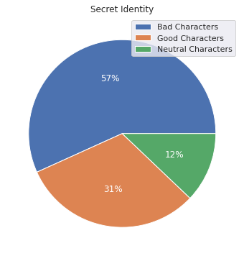
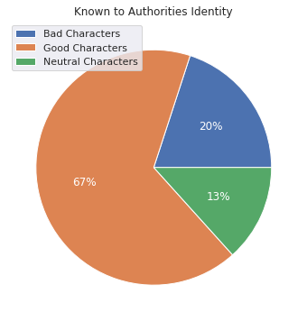
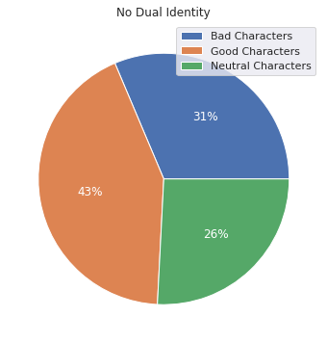
Bad characters tend to have unknown or secret identities
Almost 75% of characters with public identities are good or neutral
67% of good characters have known to Authorities identity

Slide 14
The End

